Slide 1


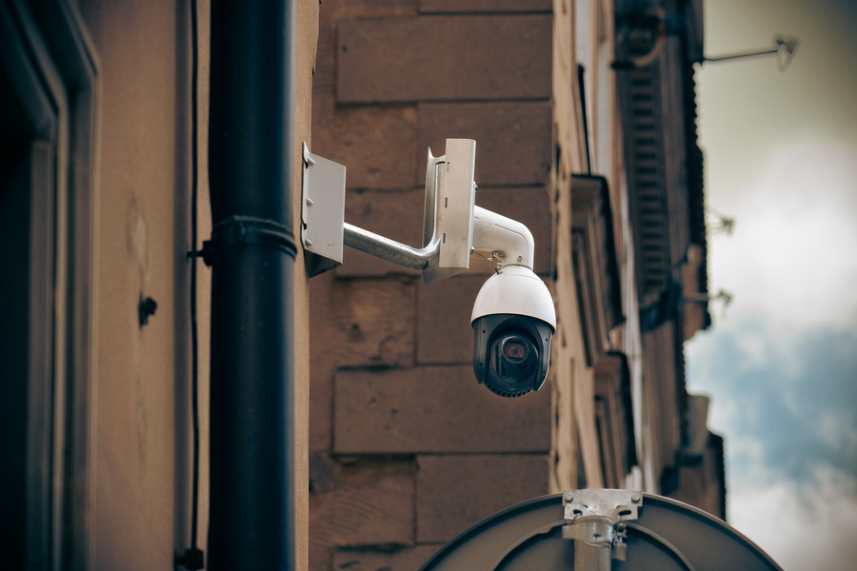

Bright TV
Viewer Usage Presentation
Redefining Televison Through Smart Vision
www.BrightTV.com
www.BrightTV.com
Presented By:
Nkululeko Choma

Slide 2
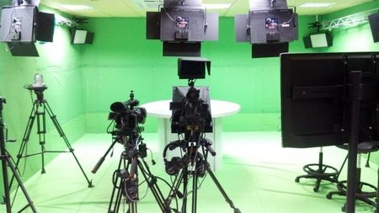

Table of Content
Telecommunication at work
Introduction
Usage Trends and Insights
Recommendation
Conclusion
At BrightTV, we believe broadcasting begins with clarity. Our telecommunication systems combine advanced imaging technology and reliable performance to give viewers cutting edge programming that is objective, current and in line with broadcasting commission standards. We design our programing to educate and entertain our viewership base while also providing excellent current affairs programming with precision, innovation, and trust at the core of every frame.
hello@reallygreatsite.com

Slide 3
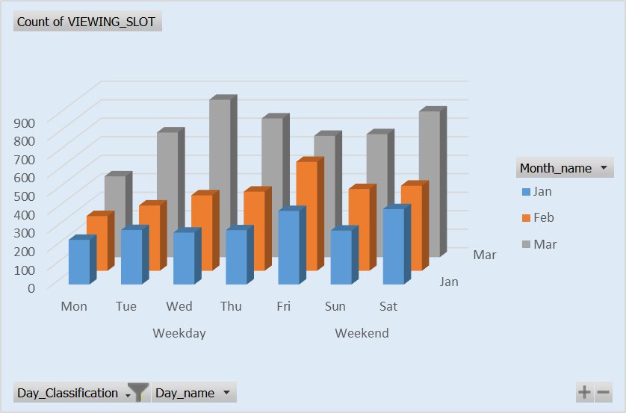
Usage Trends and insights
The usage data sample was collected frtom JAN to MAR
The first trend of usage is that March was the highest month in terms of viewership with a total of 3368 registered viewers tuning in programs. January has the lowest 1505 viewers.
Week days particularly Wednesdays have the highest viewer consumptions.
Weekends have in March had a spike in viewership this can be attributed with an international sports events which will be shown in later slides.
BRIGHT TV DATA
Alerts you instantly when unusual activity is detected.

Slide 4
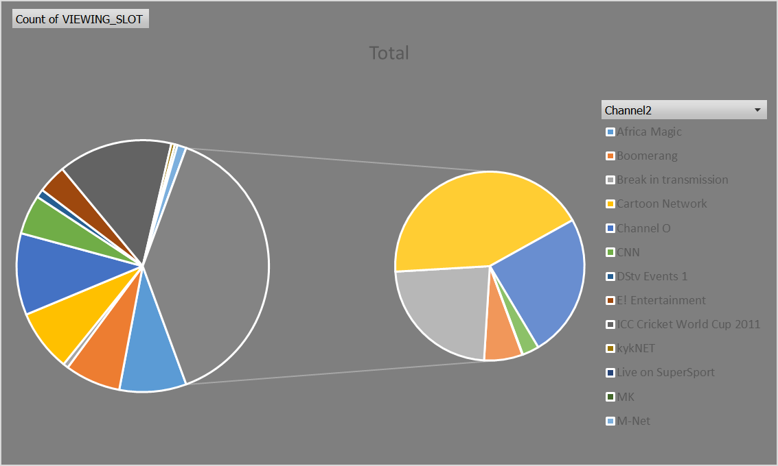
Usage trends continued by Channel
Yourkkkn text
The top 3 most watched channel on trends is Supersport Live Events (1662,) ICC Cricket World Cup event (1465) and Channel O with (1050 )viewers over 3 month period.
The most concerning and least watched channels are Kyknet(45), Wimbeldon(3), and MK (32) amongst others
We have a total of 22 Channels on Bright Tv schedule
BRIGHT TV DATA

Slide 5
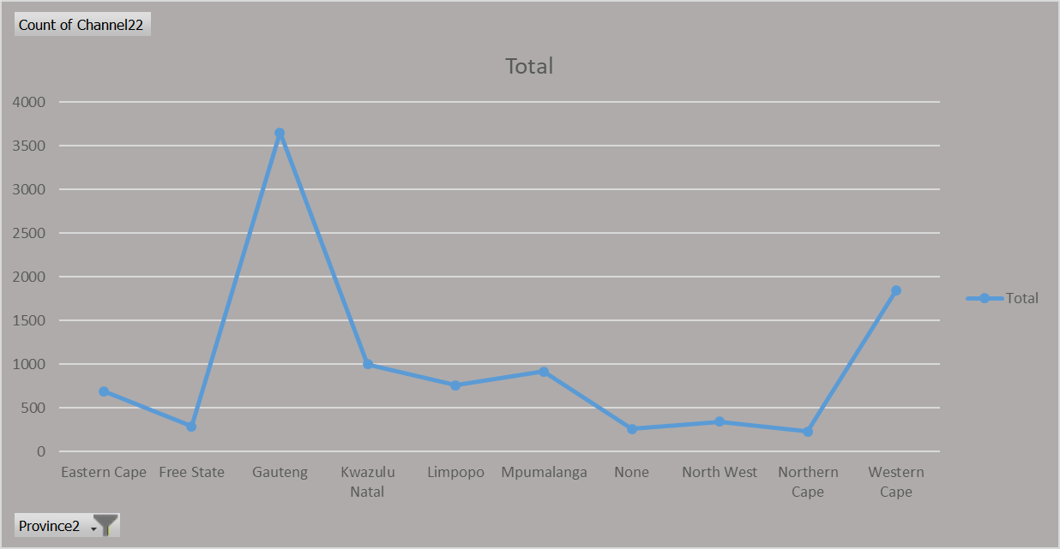

USAGE TRENDS BY PROVINCE
Bright TV has a totals of (10000) viewers registered with 36.5% of viewers being in Gauteng as the highest.
2.65% of our viewers are logged on watching however they are not registered on the data base
The Northern Cape is our lowest performing province with 2.23% of viewership
BRIGHT TV Data

Slide 6
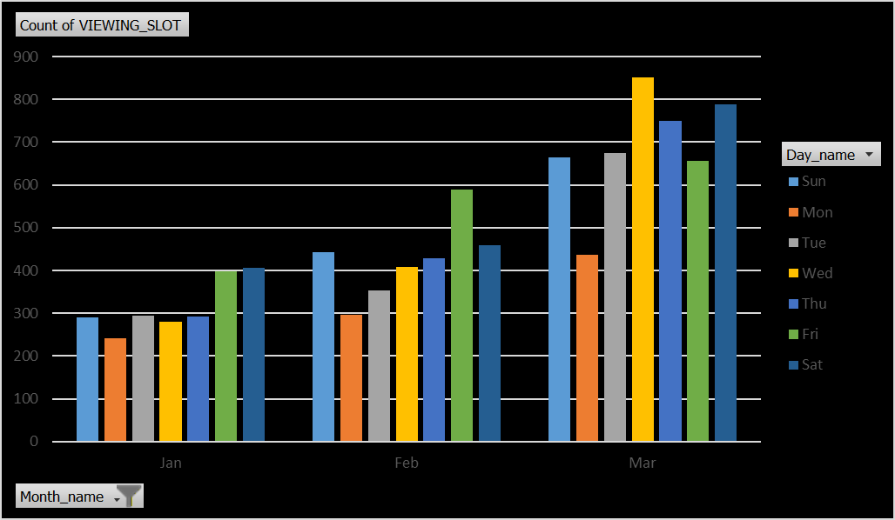
Insights and Trends By Day Name And Month
Over the past 3 months we can see that Wednesday’s and Fridays are the days with the most viewership across most channels.
The above insight suggest that March had a sharp improvement in viewers thus improving the 7 days listed in the graph.
As Bright we will need to improve Sunday and Monday viewership numbers going forward as those days are least engaged with Viewership
BRIGHT TV DATA

Slide 7
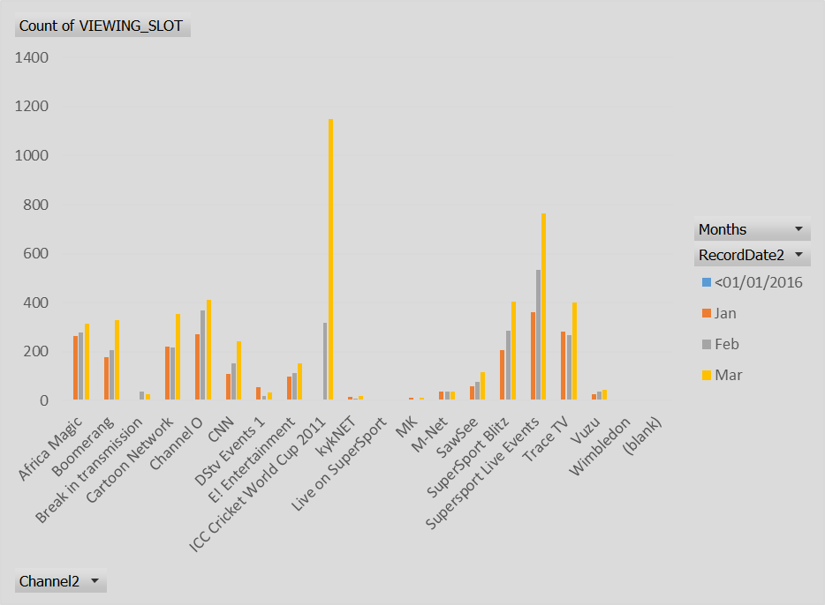
Channel Viewership By Months
Sports channel such as ICC Cricket World Cup, Supersports Live Events and Blitz are leading the viewership by channel over 3 months period
Entertainment Channels such as Trace TV, Channel O Cartoon Network Africa Magic have had a reasonable increase in viewers over the same period.
While in the same period Channels such as Kyknet, Dstv Events 1, MK have had indifferent numbers on the decline which needs to be addressed
BRIGHT TV DATA

Slide 8
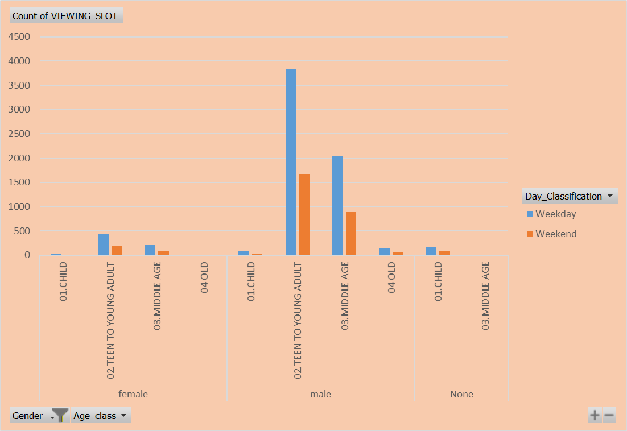
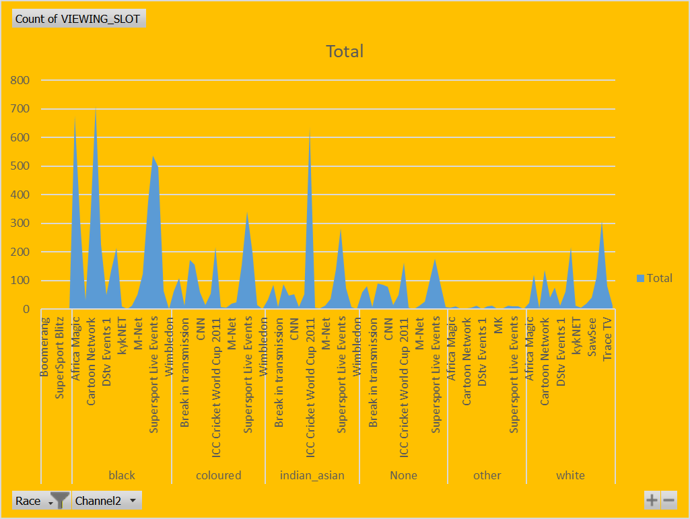
Viewership by Race and Age bracket
The above tables depicts the demographic values related to viewership by race and age bracket.
Teen to Young Adult have the highest demographic of viewership with almost 4000 registered slots

Slide 9

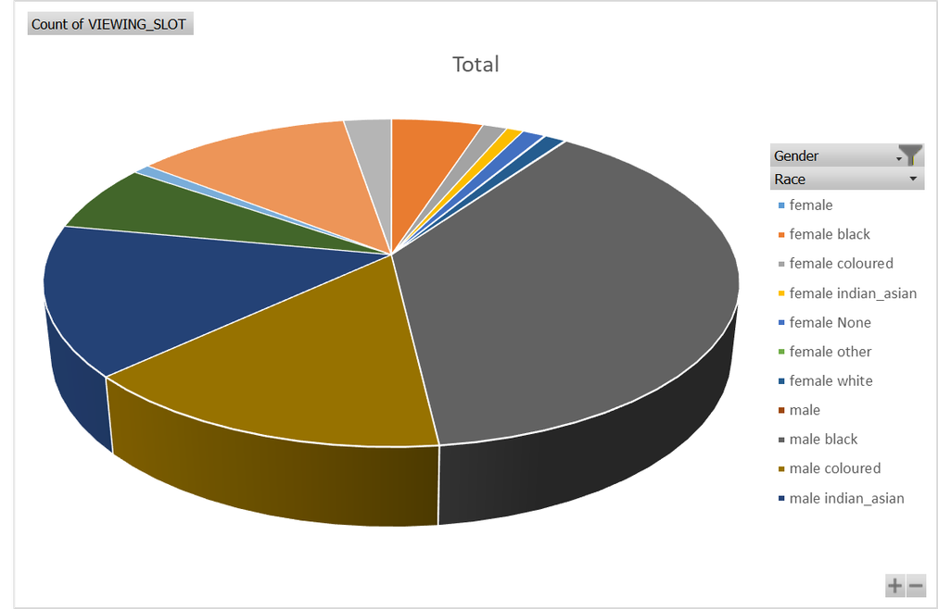
Recommendation on content
Viewer engagement
After careful data extraction and review I advise we focus on revamping content on low performing channels by conducting questionnaire to all subscribers with a particular focus on gathering information on viewership trends in the Northern Cape
Popular channels repeat content
Bright TV has information such as social media handles and emails along with Broadcast slots that can be used to advertise popular channel events for days with slow viewership to attract clients and spread the word for new subscription
Bright TV DATA
Promotions on subscriptions
Provide discount on premiums and create viewership competition along with grand prices to lucky subscribers

Slide 10
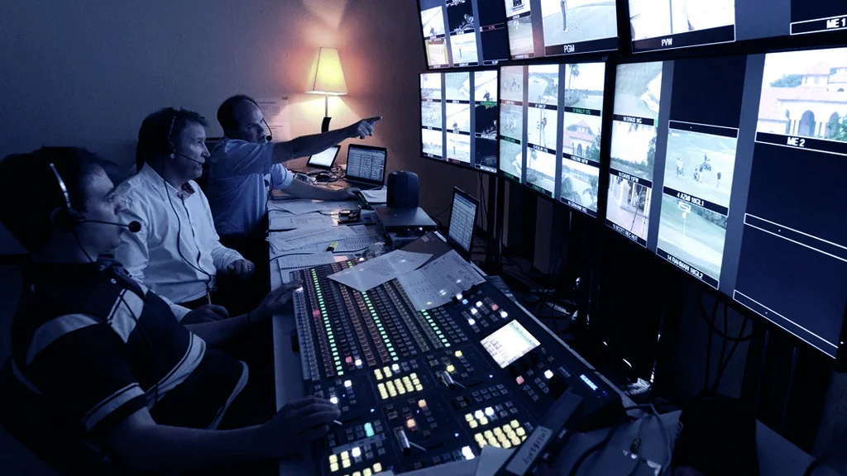
Recommendation Continued
Increase social media presence as we are leaving in a digital age and broadcasting has changed tremendously
Investigate the Cost Benefit Analysis for the CVM Team to creating a Bright TV APP that will reach Viewership in an unconventional way to improve channels
BRIGHT TV DATA

Slide 11
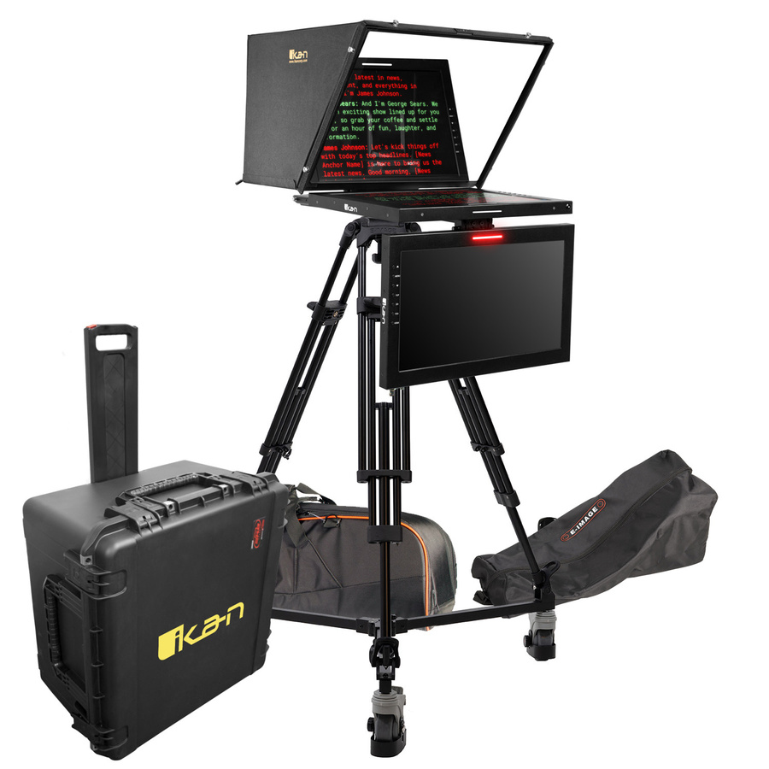
Closing
and
QUESTIONS
Securing Future Viewership Fronteir
BRIGHT TV DATA

